Slide 1
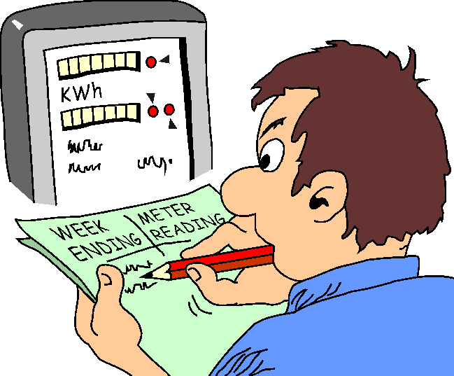
Research skills and design
Referencing and citations

Slide 2
Referencing format
All sources cited in the literature review should be listed in the references.
  Examples of referencing methods are
  Harvad referencing format
  APA referencing format
  IEEE referencing format.

Slide 3
APA Referencing format
‘APA’ stands for American Psychological Association
It is one of the most common referencing format

Slide 4
APA Citation format
Citation refers to in-text referencing.
Format1: Author Name(s)(year of publication), ..............text....
Usually this format used at the beginning of the text.
Example:
Azar & Martin (1999), found that...............................
Format2: -----------text----------------- (Author,Year of publication).
Example :
Language involves attaching meaning to symbols (Samovar & Porter, 1997).

Slide 5
APA Citation format
Direct quotation –when quoting directly from another author, use quotation marks around the quote and include page numbers
Example:
Samovar & Porter (1997), point out that "language involves attaching meaning to symbols" (p.188).
Alternatively, “Language involves attaching meaning to symbols" (Samovar & Porter, 1997, p.188).

Slide 6
APA Citation format
Citation to more than one source should be ordered alphabetically or Chronologically(according to year of publication)
Example1:
More recent studies (Bartle tt, 1992; James, 1998) show that…
Example2:
The researchers (Brown, 1876,p.42; Bartlett, 1992, p.54; James,1998, p. 45) refer to....................

Slide 7
APA Citation format
For Citation with three, four, or five authors, cite all of the authors the first time a reference occurs.
For any subsequent occurrences of the same reference, use the first author’s name with “et al.” signifying the other authors ,followed by the date of the publication.
Omit the year from each subsequent occurrence of the same reference falling within the same paragraph
Example:
......text.... (Smith, Rubick, Jones, & Malcolm, 1995).
Smith et al. (1995), argued that. . . .
......text........... (Smith et al., 1995).

Slide 8
APA Citation format
For a source with six or more authors, include only the first author's name followed by "et al."
Example:
Peffer et al. (1997) observed that,. . . .
..............text.........(Peffer et al., 1997).

Slide 9
APA Citation format
If a source has a group (corporation, government agency, association, etc.) as an author, the name is usually spelled out in every text citation.
However, if the name is long and the abbreviation is easily recognizable or understandable, spell it out for the first text citation and abbreviate for subsequent citations.
Example:
First text citation:
(Association of College and Research Libraries [ACRL], 1996)
Second or subsequent citations:
..........................(ACRL, 1996) .
ACRL (1996) found that. . . .

Slide 10
Reference list
Reference list is provided at the end of dissertation or proposal
It consists of full bibliographic information for each citation
The list is ordered alphabetical by author.

Slide 11
Guidelines for Reference list
Alphabetize the list of sources by the author 's (or editor's) last name;
if there is no author or editor, alphabetize by the first word of the title other than a, an, or the.
Use initials for an author's first and middle names.
For two or more works by an author, arrange the works by date, recent work first.
Cite personal communications only as in text citations—do not include them in the reference list.

Slide 12
Guidelines for Reference list
With two to seven authors, use all authors' names rather than "et al" unless there are eight or more authors.
Start with the last name and use initials for the first and middle names for all authors. Instead of the word "and," use an ampersand (&) and separate the names with commas.
Example:
Krause, K.-L., Bochner, S., & Duchesne, S. (2006). Educational psychology for learning and teaching (2nd ed.). South Melbourne, Vic., Australia: Thomson.

Slide 13
Reference list
Referencing Books
Put the title of a book after the year of publication.
Book titles and subtitles should be italicized.
Capitalize only the first letter and proper nouns in a title or subtitle
Include the city and official state, followed by the publisher's name.
State name can be omitted if the city is well known.
Example:
Wilson, C., & Grant, J. (Eds.). (1981). The Directory of Possibilities. New York: Rutledge Press.

Slide 14

Reference list
The publication date should appear in parentheses directly after the last author's name; put a period after the final parenthesis.
Example:

Slide 15
To reference journal articles, use a capital letter for Key words.
Journal title and Volume are Italized, followed by the issue number in brackets and page numbers (not italised) .
Reference list
Example:

Slide 16
Reference list
Double space each entry and use hanging indentation (the first line of an entry isn't indented, but every subsequent line in the entry is indented five spaces)
Examples:

Slide 17
Reference list
Retrieval information must be given for electronic sources. The statement should provide the URL, or website address, of the source.
Example:

Slide 18
Reference list
For publication without dates, use n.d. (no date) when a publication date is not known.
For internet articles, indicate url where the article was retrieved from
Example:

Slide 19
Reading exercise
Read the following referencing and distinguish them APA .
Harvard referencing format
IEEE format.

Slide 20

End
Thank you
Questions

